Slide 1

Case Study

Slide 2
Agenda
Data Understanding
Data Preparation
Overview of Hours and Cost perspective.
Impact Of Double time and Overtime
Turnover Analysis
Solutions to reduce Labor Cost and to avoid Turnover Analysis

Slide 3
Data Understanding
Missing Values for each column
Values are not missing at random in this data. There is a relationship between the propensity of the missingness and the missing values. For example: Employee Pay Summary Rate Sum are completely NAs for certain Job Names, and it’s not random. Hence we cannot do Median/Mean imputation but rather depend on other information to fill in those NAs
Column Names | Number of NAs
Source | 0
Location | 0
Employee_ID | 997
Job Name | 215
Employee Pay Summary Business Date` | 0
Pay Category Name | 0
Employee Pay Summary Net Hours Sum | 0
Employee Pay Summary Rate Sum | 102625
Pay Amount Sum | 9516

Slide 4
Data Preparation
Correcting the Employee Pay rate Column.
Regular pay rate is not constant and consistently varying for every employee significantly everyday. Example: 10027 has a regular payrate of $10 on 2015-05-27 and $20 on 2015-06-03
I am assuming that it needs to be constant, hence for every employee, I individually computed an average regular pay rate for each month and assigned that as a fixed value.
For NAs, I (computed the total Pay sum column)/(number of hours worked) to fill in the Null values.
Double time Pay rate:
Based on the general definition, Double time = 2*Regular Pay rate for that date, but it’s not consistent in the data, hence, I used the regular pay rate and multiplied it by 2 to get the Double time values
Overtime Pay Rate:
Similarly for Overtime, I computed it by overtime = 1.5*Regular

Slide 5
Data Understanding
Total number of Hours worked in a day:
For any employee, It can’t be <0 or more than 18hours to be practical.
There are many values in the data which crossed the above limits.
Example: Employee ID 12970 on 2015-12-31 has worked for -10 hours
Employee ID 10848 on 2015-12-30 has worked for 25 hours.
I capped these values and rounded to the nearest possible integer which is in our range
Total Pay Sum
Total Pay Sum = Total hours * Pay rate
But, it is not consistent in the data set, hence I computed it by using the above equation

Slide 6
Data Preparation
Direct and Indirect column:
Out of 55 Job Names, only 33 Job Names have been assigned with Direct and Indirect values.
I did a Manual imputation of Direct and Indirect values by using my understanding and by using the following logic.
If Shipping & Receiving Operator II has a Direct value, and Shipping & Receiving Operator I has NA value, then we can update the Shipping & Receiving Operator I to the Direct value because both of them belong to the same team.
Created the following columns.
Months, Weekdays, Is_weekend(Yes or No)
Merged all the three data files into one for simplicity and consistency.

Slide 7
Overview of Hours and Cost Perspective
Average number of hours per employee in Direct/Indirect in each month
Average number of hours per employee in Direct/Indirect comparing against weekdays and weekends
Boxplot Distribution of Direct/Indirect Employee working Hours
Average number of hours Direct/Indirect Employees work per pay category
Top 5 Jobs in both Direct and Indirect jobs with higher regular, Overtime and Double time hours
Total Labor cost in Direct/Indirect in each month
Total Labour cost in

Slide 8
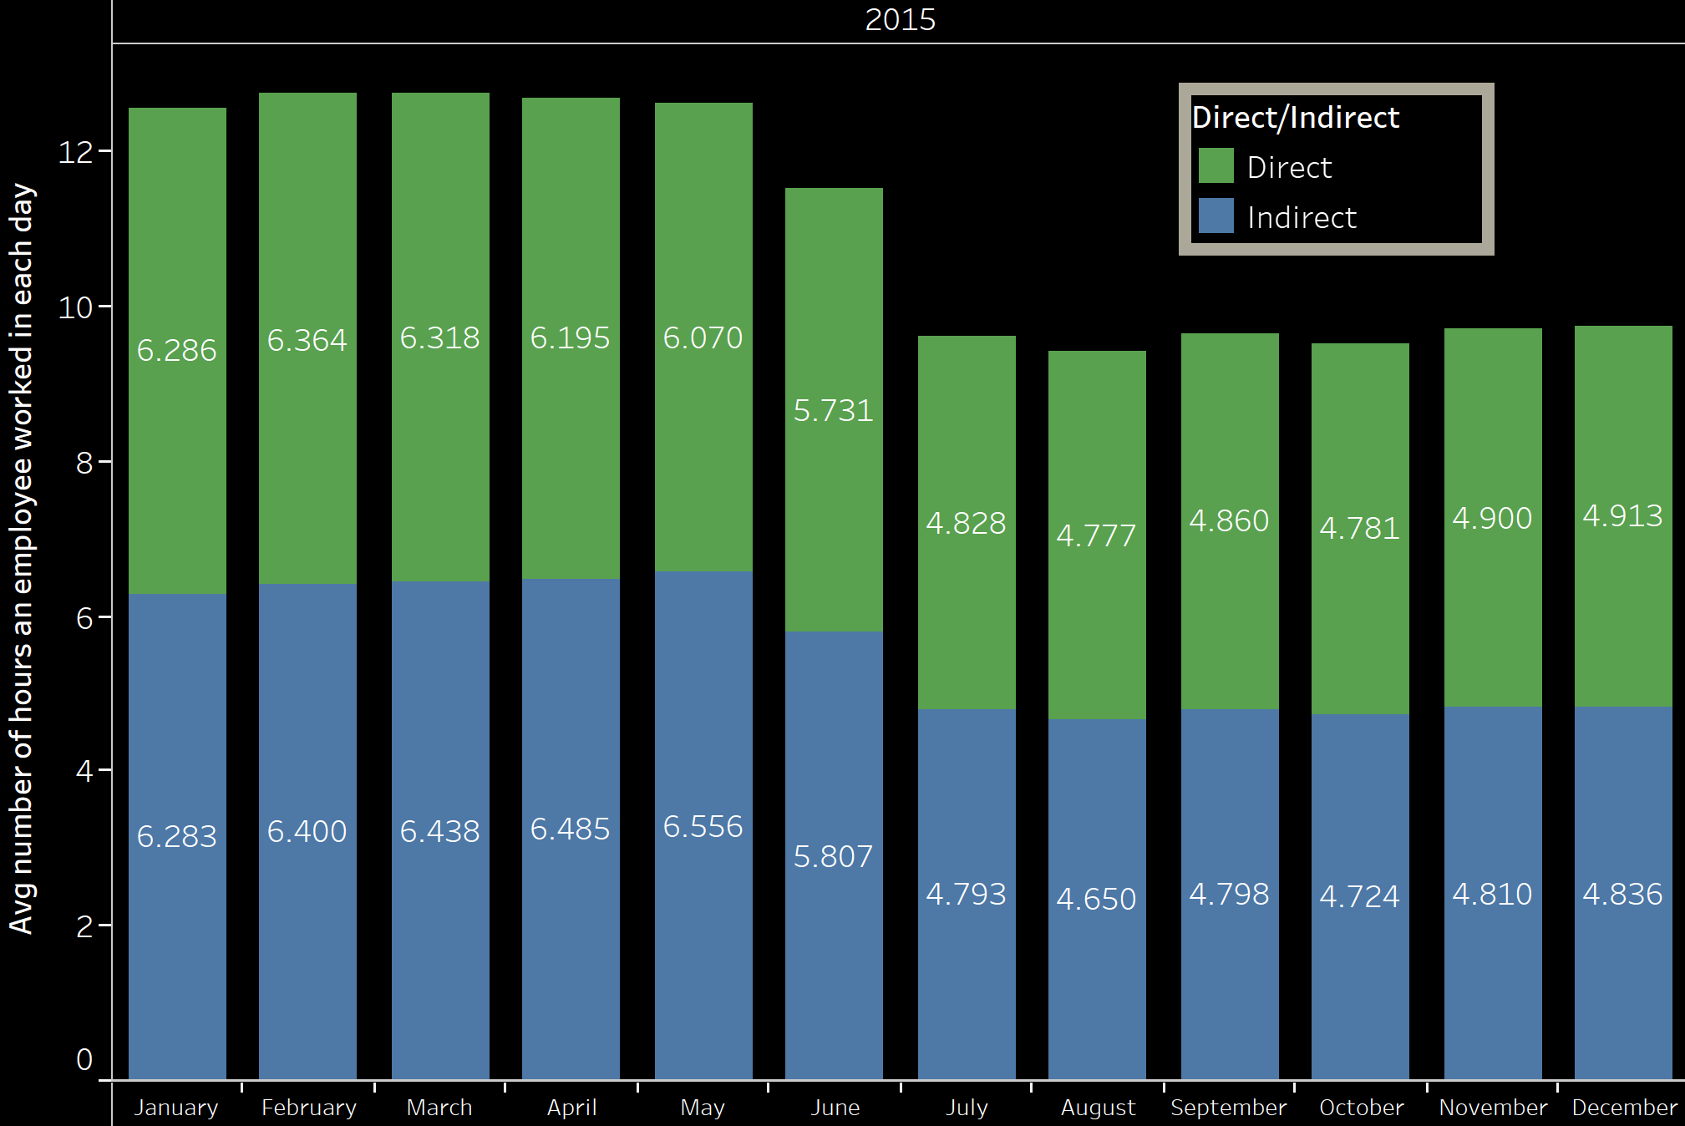
Average number of hours per employee in Direct/Indirect in each month
Insights:
Direct and Indirect employees have similar average working hours in each month. We could check in the next slide if there is any difference in them for each pay category.
Note:
Average here is computed by (total number of hours an employee worked in a month)/(30 days).
We could further explore by computing (total number of hours an employee worked in a month)/(number of days an employee worked in that month). Refer to the Appendix for this graph.

Slide 9
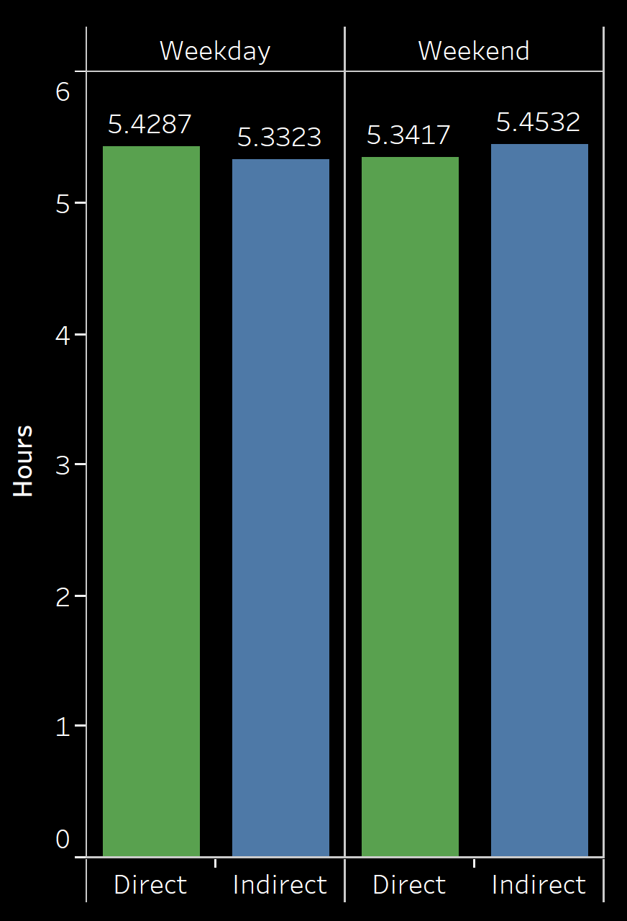
Average number of hours per employee in Direct/Indirect comparing against weekdays and weekends
Insights from Plot 1:
Direct and Indirect employees have similar average number of working hours in weekdays and weekends. On the weekdays, Direct have a slightly higher number of working hours on an average.
Note:
Average here is computed by (total number of hours an employee worked in a month)/(30 days).
We could further explore by computing (total number of hours an employee worked in a month)/(number of days an employee worked in that month)

Slide 10
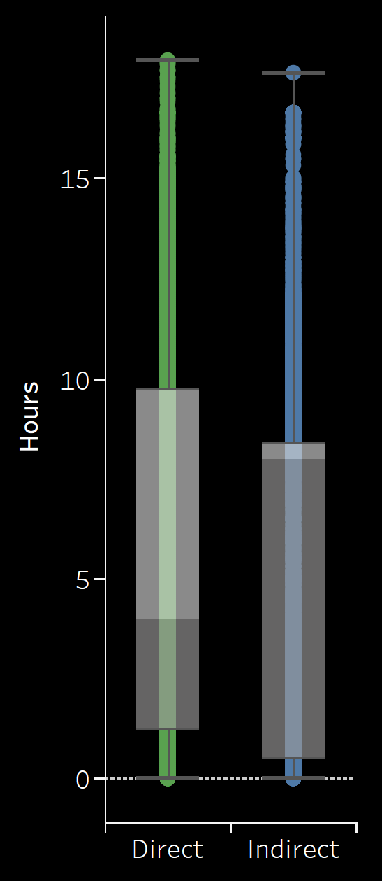
Boxplot Distribution of Direct/Indirect Employee working Hours
Purpose:
This is to quickly get an understanding of how many hours per day Direct/Indirect employee mostly work
Insights:
No significant difference, but most of the Direct employees work slightly higher than Indirect Employees
Note:
We could further dig into Normal Distribution to see the frequency of each number of hours working by Direct and Indirect Employees.

Slide 11
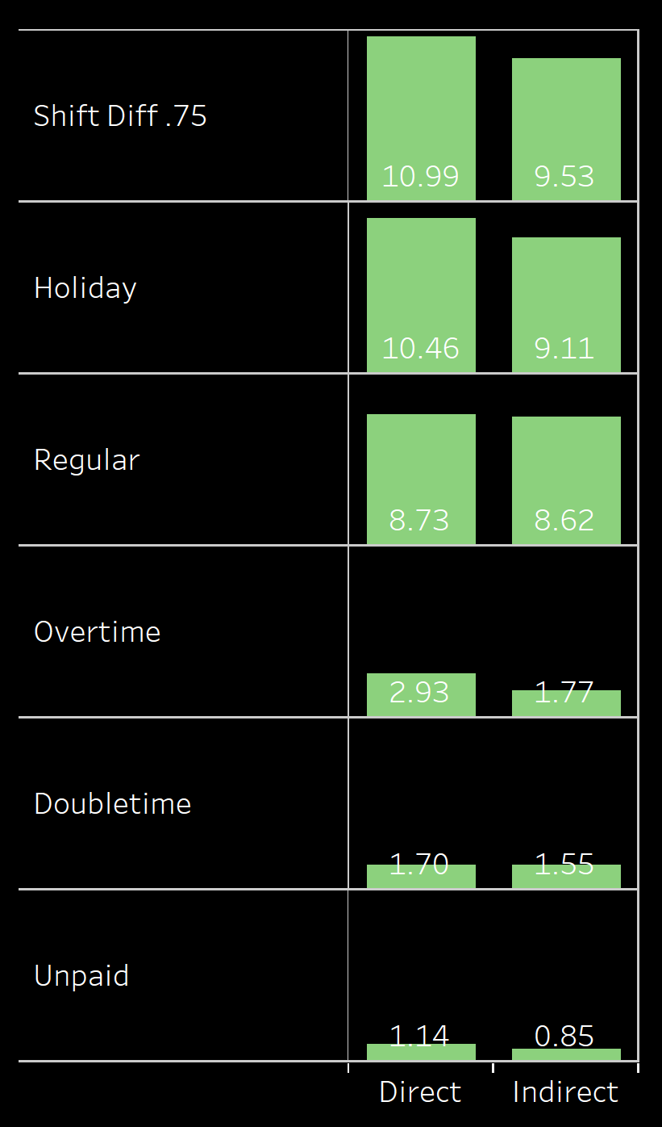
Average number of hours Direct/Indirect Employees work per pay category
Insights
Both Direct and Indirect employees have similar average number of working hours per day in each pay category
During Holidays however, Direct employees have slightly more working hours than Indirect employees. This is inline with our general intuition
Direct Employees work slightly more overtime than Indirect Employees.

Slide 12
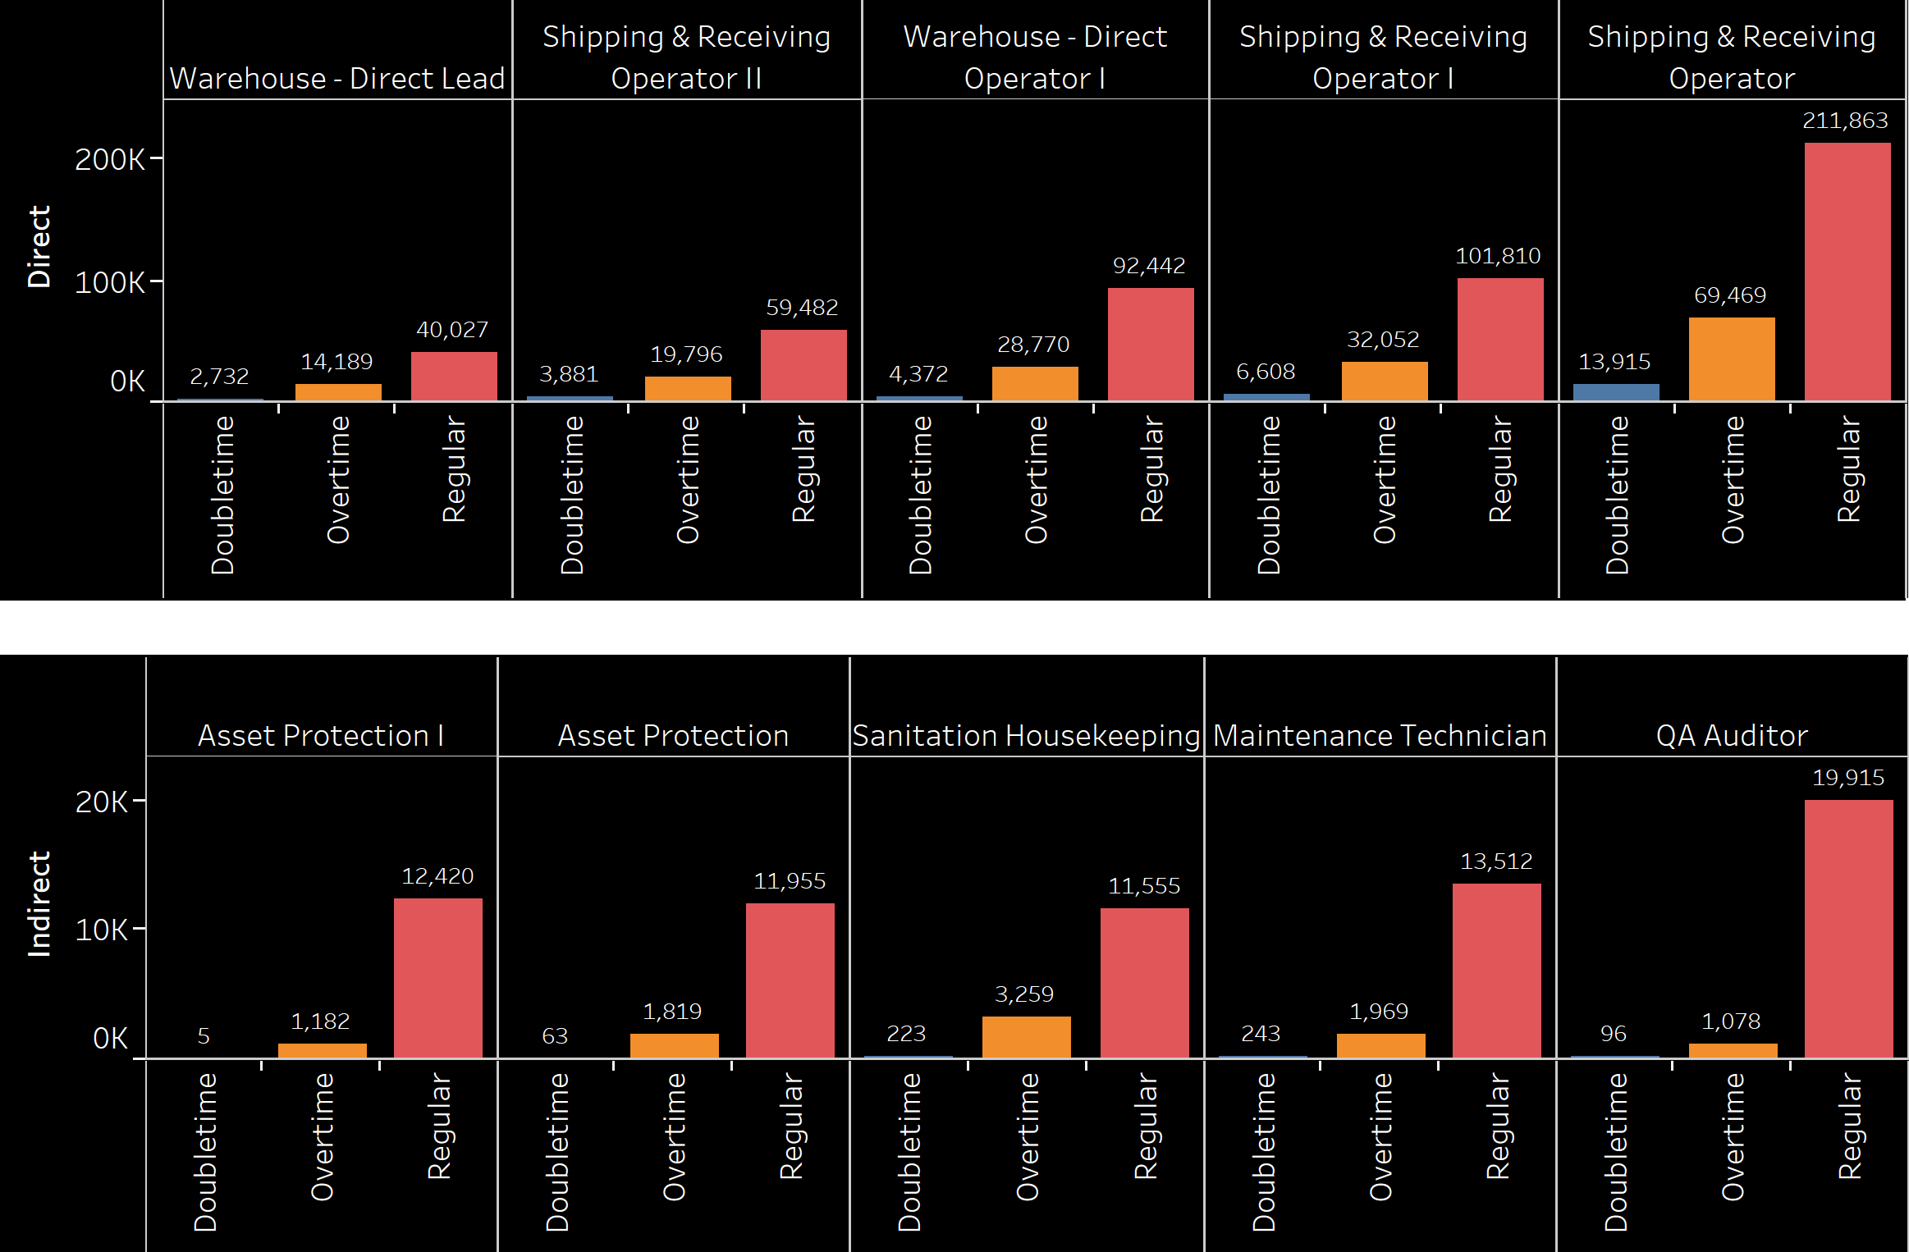
Top 5 Jobs in both Direct and Indirect jobs with higher regular, Overtime and Double time hours
Insights
Shipping & Receiving Operator from Direct has a lot of Regular working hours and Overtime hours in total.
QA Auditor has a lot of Regular working hours in total.
This is an absolute number of hours, but an average number of regular, overtime and Double time hours for the Top 5 Jobs could be more useful.

Slide 13
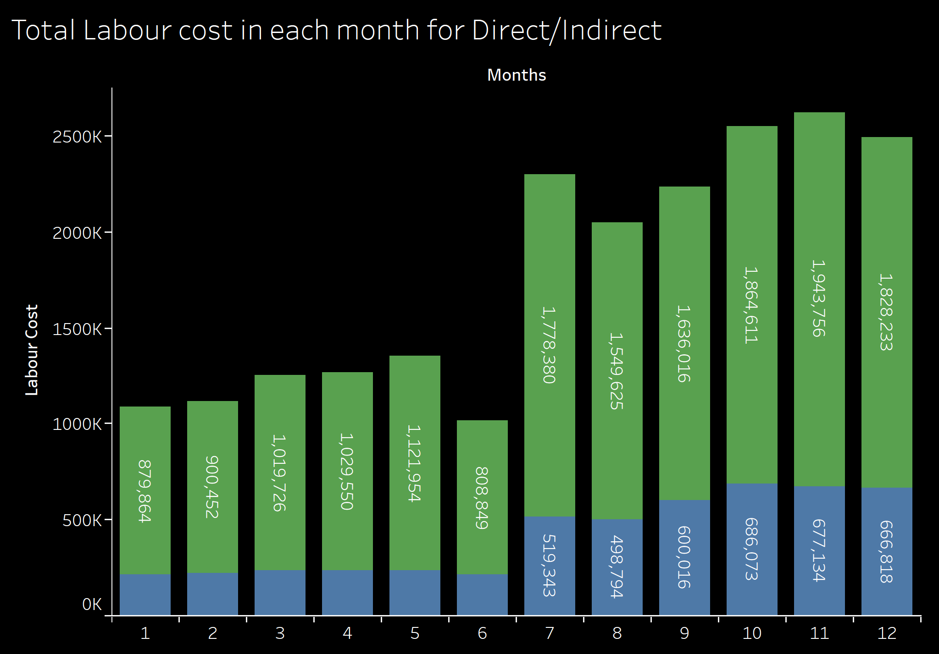
Labor Cost for Direct/Indirect in each month
Insights:
Labor Cost is huge in Q3, and Q4
Direct Labor Cost is much higher than Indirect Labor. This is because the number of employees in Direct Labor are much higher than Indirect Labor.

Slide 14
Impact of Overtime and Double time
Over time and Double time Analysis
Number of Employees in each month and Average number of hours employees worked in a day in each month
Quantitative and Qualitative Analysis to analyze the impact

Slide 15
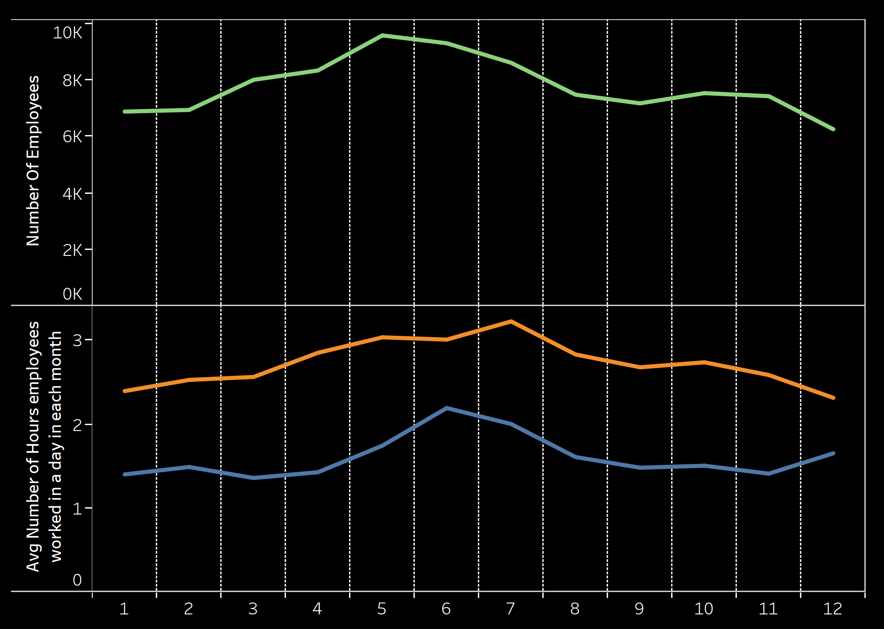
Number of Employees in each month and Average number of hours employees worked in a day in each month
Interesting Insight:
Number of employees in the month of May, June, July are higher than the other months, yet the number of Over time and Double time are still higher for those months. It could be that the Employer earlier forecasted the higher need of Employees in these months and hired the employees, but since the overtime and Double time are still higher in these months, it could mean that the hire wasn’t enough and the employees had to still work overtime and Double time for enough productivity.
Note:
There are empty fields for Employee ID, which in reality could account for the months apart from May, June and July, leading to conflict with the above insight. Hence we are assuming that those NAs are not from other months

Slide 16
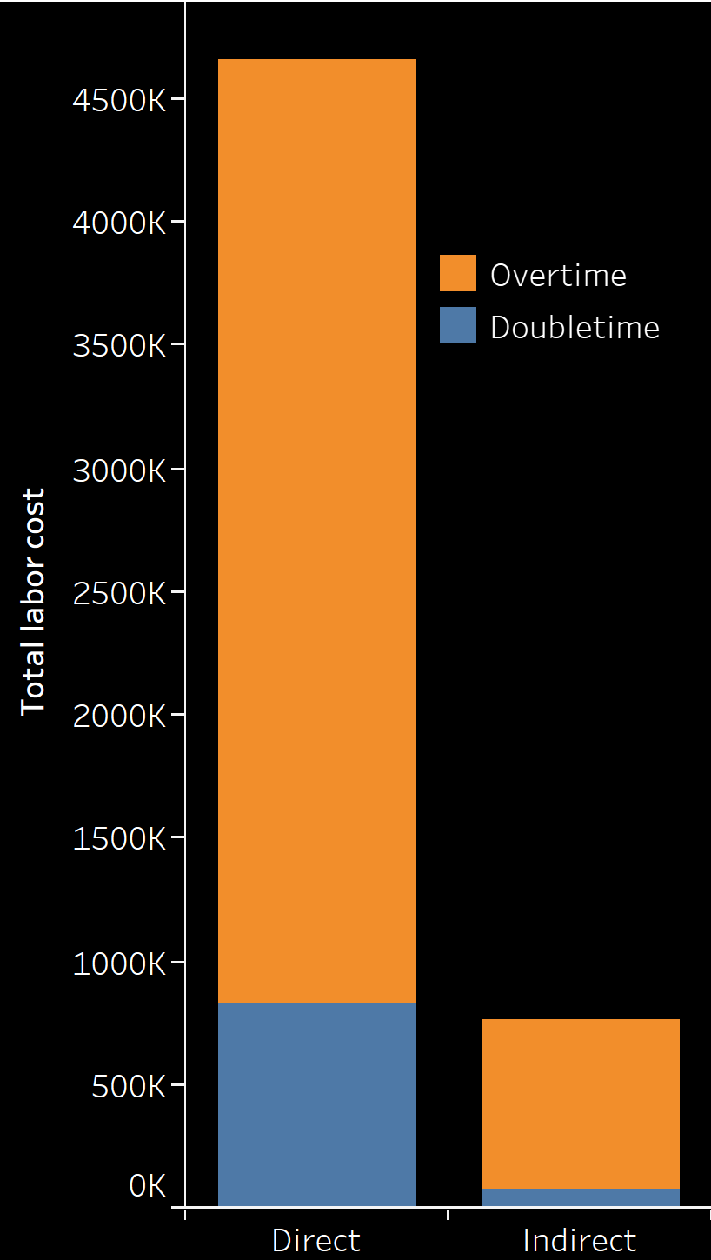
Quantitative and Qualitative Analysis to analyze the impact
Quantitative:
Cost of Overtime and Double time is huge for Direct Employees as compared to Indirect Employees. See the Plot on the right.
$5,418,280 in Total is being spent on Overtime and Double time
More overtime work leads to sick days, which in turn requires colleagues to take over the absences and will ultimately cost employers as a result.
Qualitative:
Longer work hours lead to increased stress, sick days and higher turnover rates
Efficiency reduces and hence less output. Employers end up paying more for less work.

Slide 17
Turnover Analysis
Number of Employees hired and left in each month
Number of Direct/Indirect Employees Left the jobs in each month
Top 5 jobs with the most attrition in Direct/Indirect

Slide 18
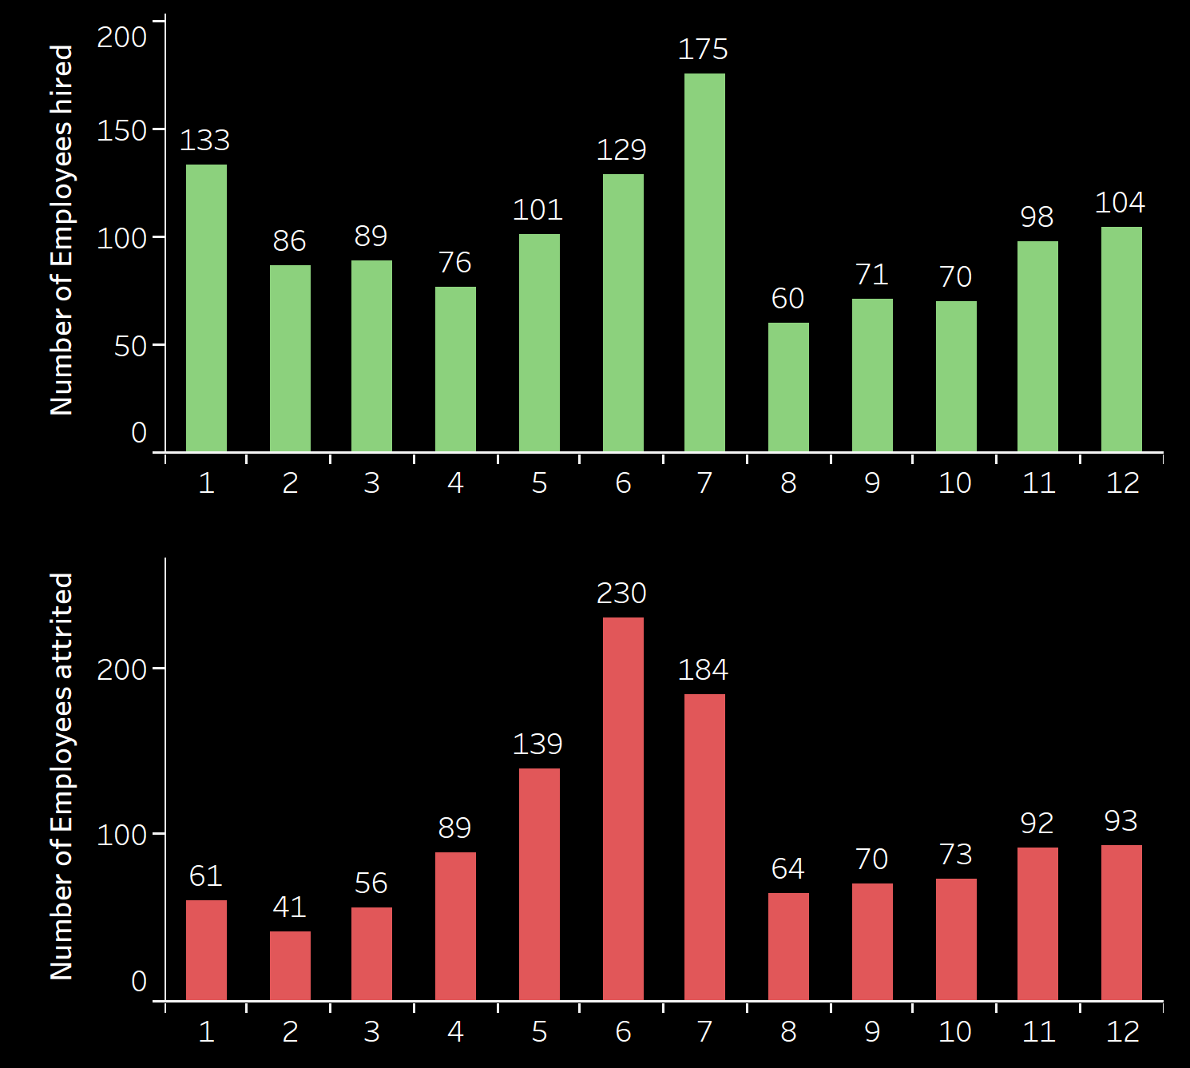
Number of Employees hired and left in each month
Insights from Plo1:
Number of new employees hired are higher during the months of January, May, June and July.
Insights from Plot2:
Number of Employees left are higher during the months of May, June and July. There is a huge jump from May to June especially.

Slide 19
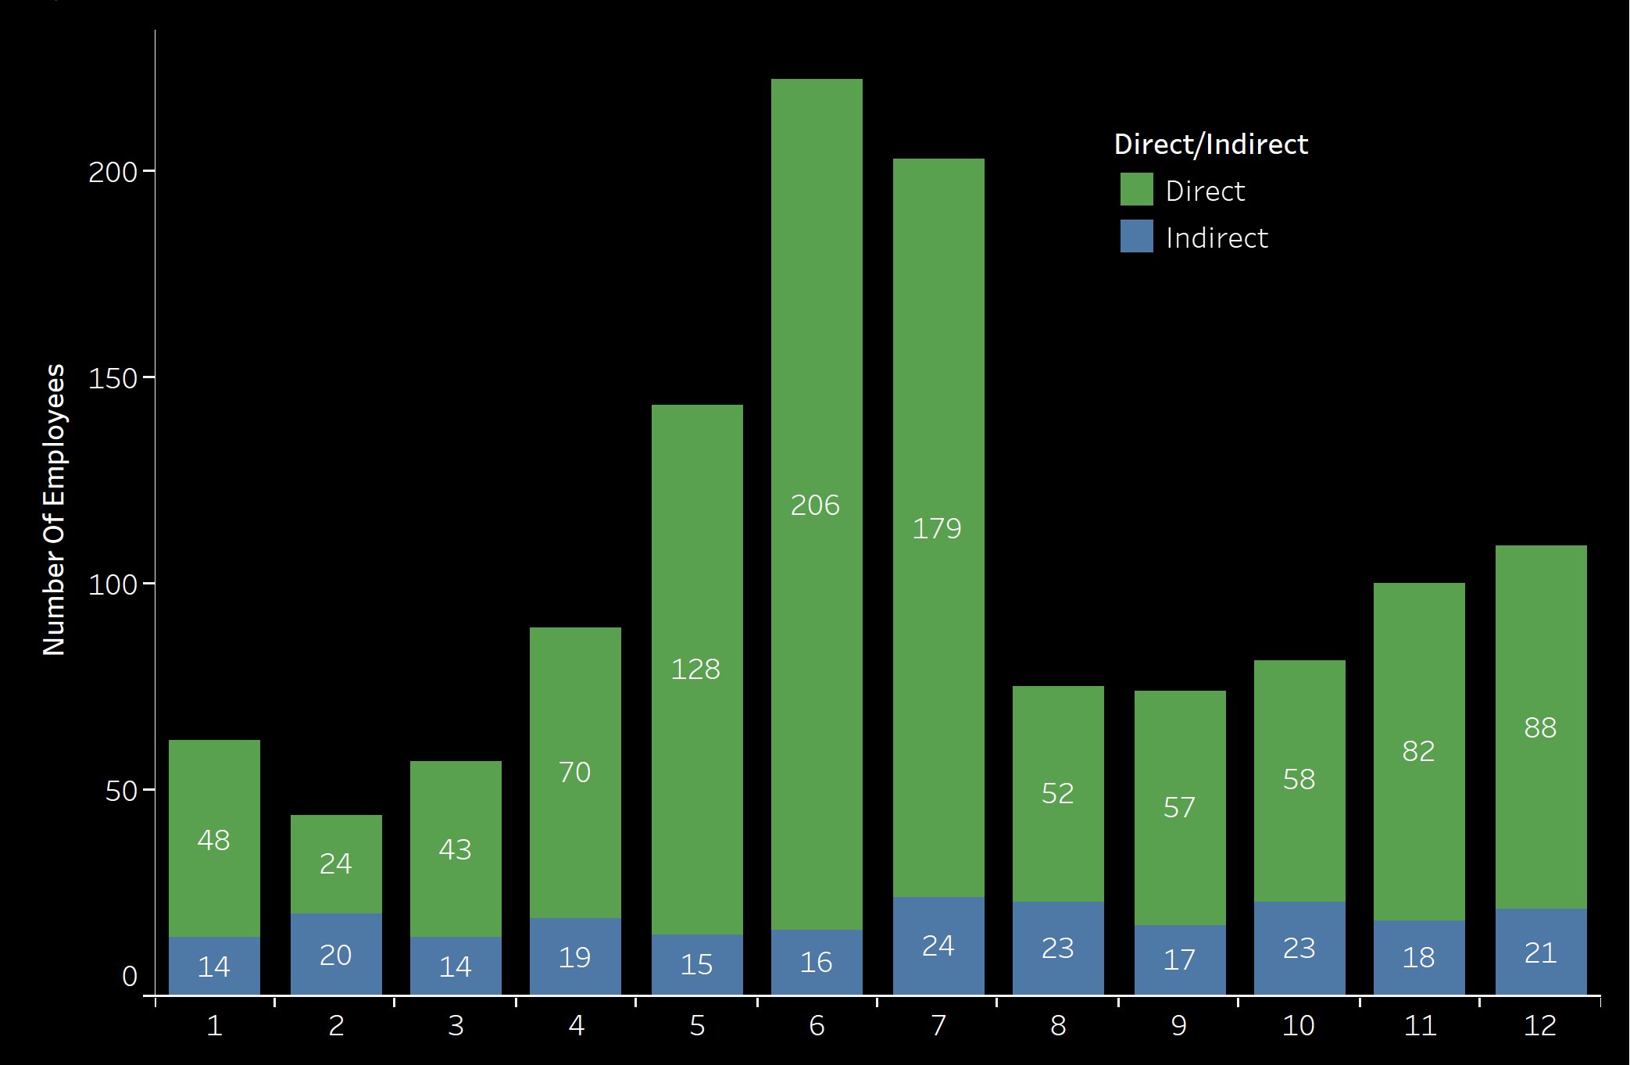
Number of Direct/Indirect Employees Left the jobs in each month
Insights:
Direct Employees in general have the most attrition in every month.
During May, June and July, so many Direct Employees have left the jobs. It is during these months that we have figured earlier that Over time and Double time were much higher
Earlier we have seen that particularly Direct Employees have more overtime and double time working hours. We can further explore to see if there is a strong correlation/causation between Attrition and the Overtime and Double Working hours.

Slide 20
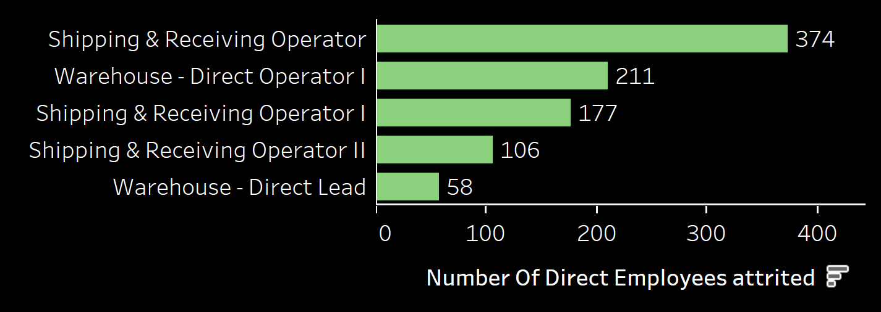
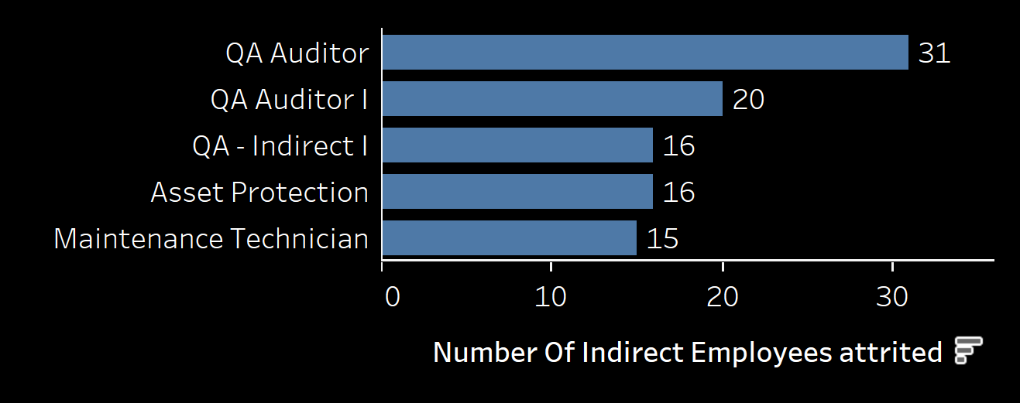
Top 5 jobs with the most attrition in Direct/Indirect
Insights:
Further looking into Cumulative distribution, we see that the Top5 Jobs account for 40% of the attrition, which is very high.
Earlier, we found that these Jobs require a lot of Double time and Overtime. This suggest that there isn’t probably just the correlation but also the causation. It reinforces the fact that Over time and Double could lead to Attrition.
Employers could intervene and consult these employees to get a thorough understanding of what causing them to leave the jobs.

Slide 21
Solutions and recommendations
Solutions on how to reduce labor cost
Solution to avoid Turnover(Quantitative Approach)
Solution to avoid Turnover Qualitative Approach.

Slide 22
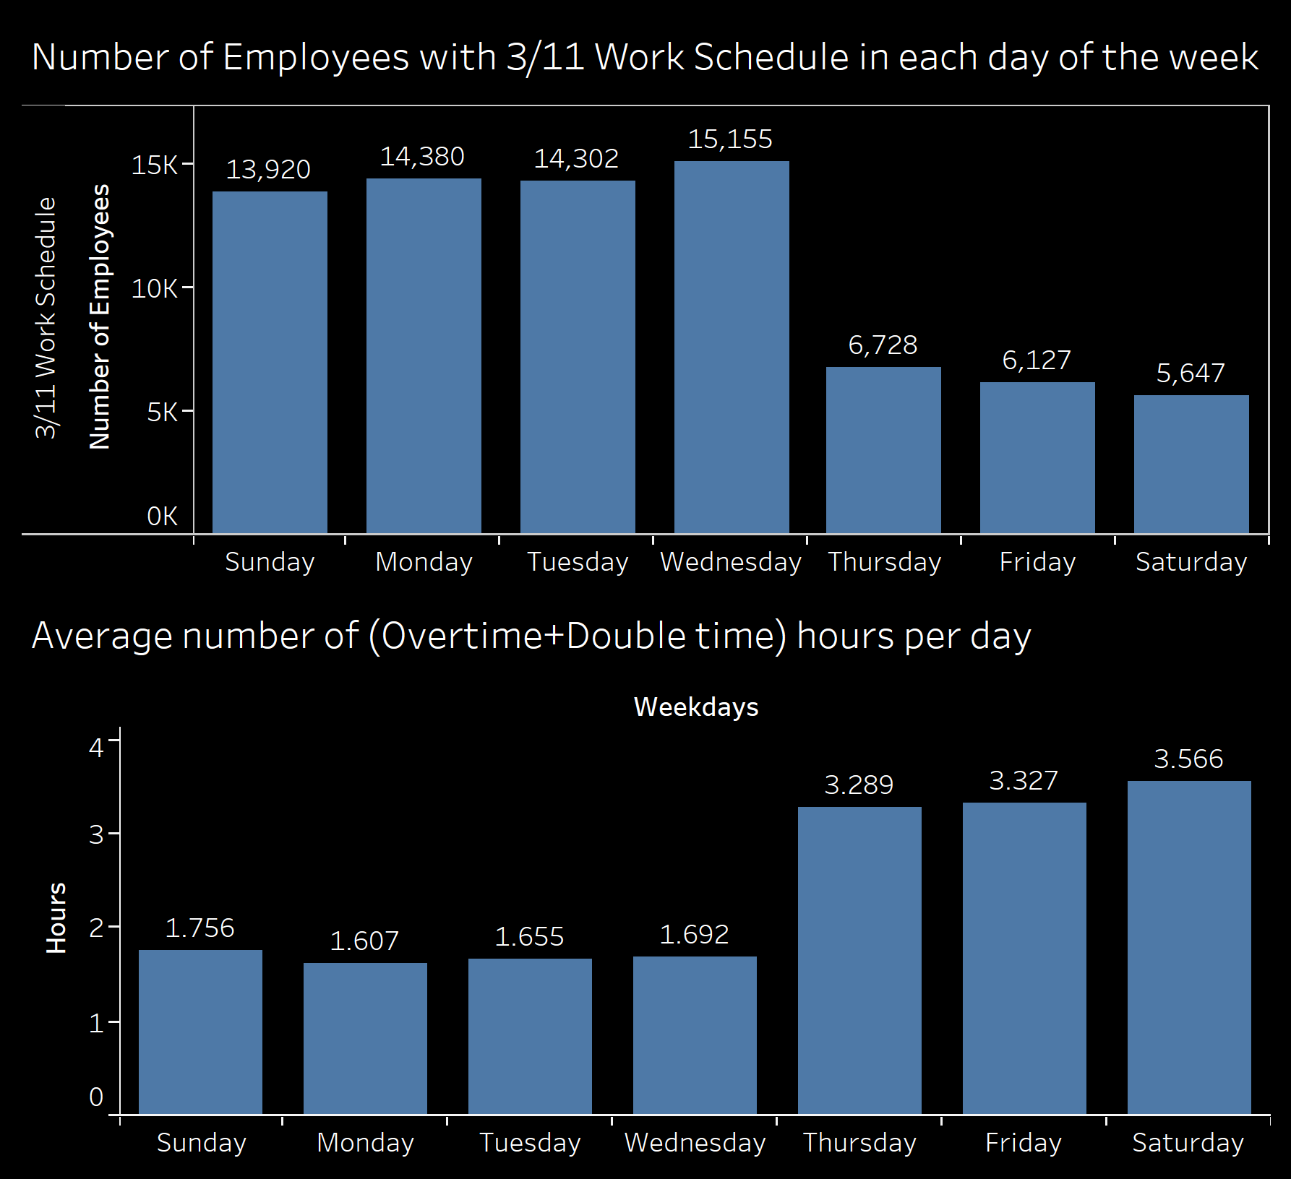
Solutions on how to reduce labor cost
Overtime and Double time are generally employed by employees who are on 4/10 and 5/8 work schedule.
Overtime and Double is very expensive, leading to a lot of Labor cost, and we need to avoid them
Here, in the bottom graph we see that a lot of Overtime and Double time happens during the last 3 days of the week, While employees with 3/11 schedule mostly work during the first 4 days of the week as seen from the first graph.
Either we could move the current 3/11 employees to the weekends with a little more incentive or we could hire more new employs who are willing to work during the weekends.

Slide 23
Solution to avoid Turnover(Quantitative Approach)
Finding out the Top jobs in Direct and Indirect with the highest attrition, which we did earlier. We could connect to those employees to understand what’s causing them to leave, thereby taking the necessary measures.
We also understood that May, June and July months have the highest attrition. Providing incentives during those months and changing the operations efficiency during those months could help retain as many employees as possible.
Build a Churn Predictive Model to predict who would churn.
Build a forecasting model using all previous years’ data to forecast how many hours of work the company would be needing in each month to avoid Overtime and Double time.

Slide 24
Solution to avoid Turnover Qualitative Approach.
Solutions to avoid
Incentives and rewards
Provide feedback(positive).
Reduce the work load.
Plausible Reasons
No Job Satisfaction
Overwork leading to stress
No Opportunity for growth
No positive work culture
Minimal Recognition

Slide 25
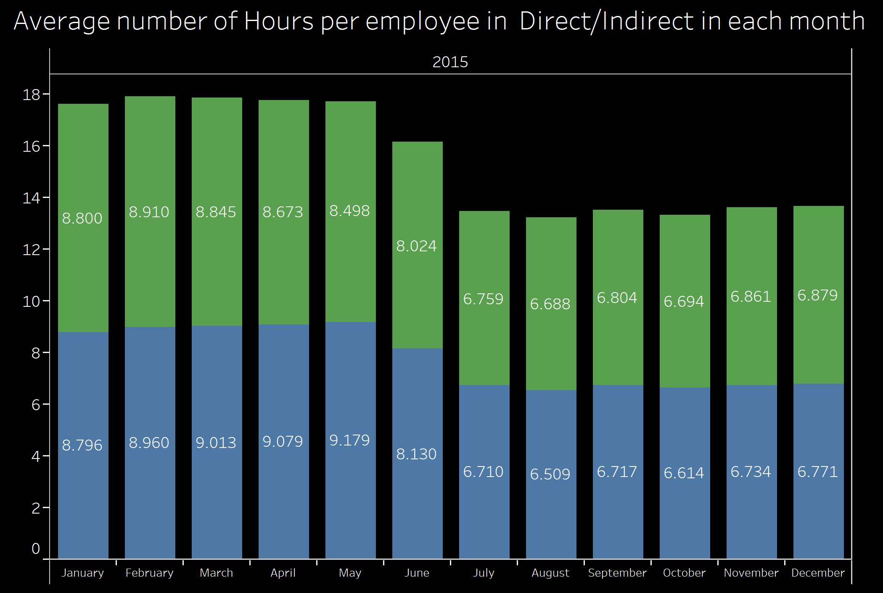
Appendix

